Slide 1


Middle East
Middle East
Middle East
Middle East
Middle East
Middle East
Middle East
Middle East

Slide 2




4
4
4
4
3 Scholastic RP
3 Scholastic RP
3 Field RP
3 Field RP
4
4
4
4
3 Support RP
3 Support RP
2 Permits
2 Permits

Slide 3
Middle East
Middle East
Middle East
Middle East
Middle East
Middle East
Middle East
Middle East

Slide 4
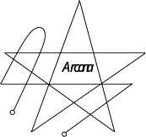
4
4
4
4
2 Permits
2 Permits
2 Permits
1 Eldritch RP
4
4
4
4
1 Eldritch RP
1 Eldritch RP
1 Eldritch RP
1 Eldritch RP

Slide 5
Middle East
Middle East
Middle East
Middle East
Middle East
Middle East
Middle East
Middle East

Slide 6


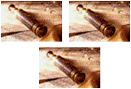

4
4
4
4
OR
OR
3 Scholastic RPs OR 2 Permits
3 Field RPs OR
2 Permits
3 Support RPs OR
2 Permits
2 Permits OR
1 Eldritch RP
4
4
4
4
OR
OR
OR
OR
2 Permits OR
1 Eldritch RP
2 Permits OR
1 Eldritch RP
2 Permits OR
1 Eldritch RP
2 Permits OR
1 Eldritch RP

Slide 7
Middle East
Middle East
Middle East
Middle East
Middle East

Slide 8

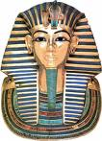



8
8
8
8
FIND!
Dead Sea Scrolls
FIND!
King Tut's Tomb
FIND!
Valley of the Kings
FIND!
Lost City of Ur
8
FIND!
Ruins of Babylon

Slide 9
Legendary
Legendary
Legendary
Legendary
Legendary
Legendary

Slide 10
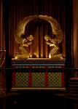
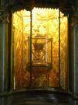
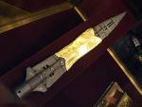

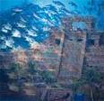

12
12
12
12
Ark of the Covenant
The Holy Grail
Spear of Destiny
Templars’ Treasure
Professor and RAs can explore for free
Professor can Scheme for free
Add 3 dice to Professor’s or RA’s dice pool
Collect $3/turn
12
12
Lost City of Atlantis
Fountain of Youth
Place RAs for free
Get 2 extra VPs for each published Find at game end

